Slide 1
Form Generator

Slide 2
Overall Goal
At the core of this program is the concept of connecting the dots (nodes). The first and most simple way to connect nodes are to use straight lines (y=mx+b)
4
3
1
2

Slide 3
Overall Goal
The second way to connect nodes is to allow curved lines as well as straight lines with no regard as to what happens at the junction of those lines and curves.
4
3
1
2

Slide 4
Overall Goal
The third way to connect nodes is to allow only curved and straight lines that form smooth transitions at each dot.
4
3
1
2

Slide 5
Complexity
Smooth transitions at the nodes
  Requires the matching of slopes at the node (differentiation)
The use of simple unit functions as the building blocks for more complex curves
  Requires linear and rotational transformation
  Requires node insertion to smoothly transition between incompatible nodes
Fault checking to ensure that two lines in an arbitrarily numbered system do not cross

Slide 6
node_{j+1}
Δy_{j}
mLine_{j}
nRef_{j}
nUnit_{j}
mRef_{j}
mUnit_{j}
curve_{j}
Δx_{j}
node_{j}
Directional parameters = past_{j} and future_{j}
Transformational parameters = L_{j} and R_{j}

Slide 7
Unit Functions
Smooth curves with only one bend
Δx and Δy may only change direction once at any point along the curve
They are bound between 0 ≤ x ≤ 1 and 0 ≤ y ≤ 1
  This involves a transformation from reference coordinate space to unit coordinate space
There are 10 classes of unit functions
C Unit Function Exponent Bound y = 1-x concavity m_{Unit} n_{Unit}
y = x^{r} (r > 1) asym + 0 r
y = x^{r} (1 > r > 0) asym - ∞ r
y = 1-(1-x)^{r} (1 > r > 0) asym + r ∞
y = 1-(1-x)^{r} (r > 1) asym - r 0
y = (1-(1-x)^{r})^{1/r} (1 > r > 0) sym + 0 ∞
y = (1-(1-x)^{r})^{1/r} (r > 1) sym - ∞ 0
y = ? sym + r 1/r
y = ? sym - 1/r r
y = ? asym + r s
y = ? asym - s r

Slide 8
Unit Functions 2
Why use unit functions?
They are easily differentiable and solvable at x=0 and x=1
They are the simplest curves and any complex curve can be reduced to multiple unit functions
Having control of the exponents in these simple curves allows for greater manipulation of the entire shape and may reveal aesthetic patterns

Slide 9
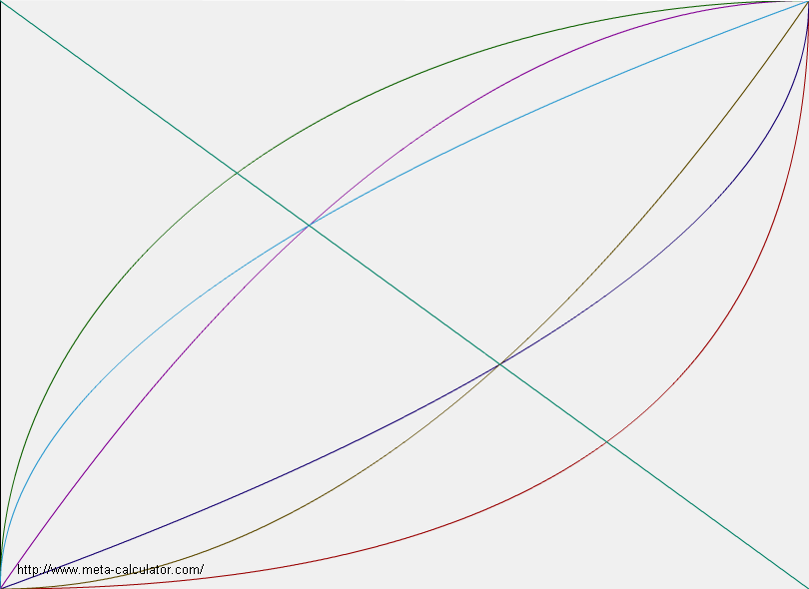
The Known Curve Classes
(with 2.0 and 0.5 as parameters)
(1,1)
Class
1 (Brown) y = x^{r} r=2
2 (Lt. Blue) y = x^{r} r=1/2
3 (Dk. Blue) y = 1-(1-x)^{r} r=1/2
4 (Purple) y = 1-(1-x)^{r} r=2
5 (Red) y = (1-(1-x)^{r})^{(1/r)} r = ½
6 (Green) y = (1-(1-x)^{r})^{(1/r)} r = 2
(0,0)

Slide 10
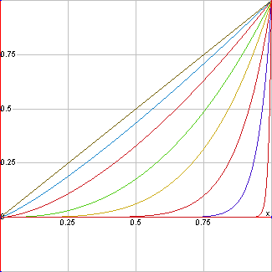
Class 1
y = x^{r}
r > 1
y’ = rx^{r-1}
y’ (0) = m_{Unit} = 0
y’ (1) = n_{Unit} = r
The top line is y = x
for comparison
From top down, r = 6/5, 8/5, 5/2, 4, 8, 20, 100

Slide 11
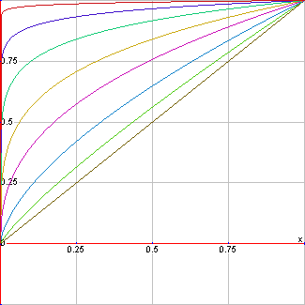
Class 2
y = x^{r}
0 < r < 1
y’ = rx^{r-1}
y’ (0) = m_{Unit} = ∞
y’ (1) = n_{Unit} = r
The bottom line is y = x
for comparison
From bottom up, r = 5/6, 5/8, 2/5, 1/4, 1/8, 1/20, 1/100

Slide 12
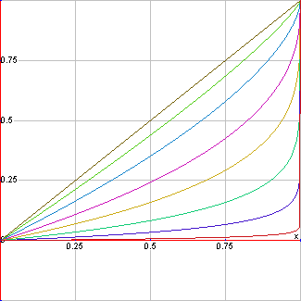
Class 3
y = 1-(1-x)^{r}
0 < r < 1
y’ = r(1-x)^{r-1}
y’ (0) = m_{Unit} = r
y’ (1) = n_{Unit} = ∞
The top line is y = x
for comparison
From top down, r = 5/6, 5/8, 2/5, 1/4, 1/8, 1/20, 1/100

Slide 13
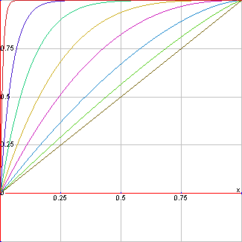
Class 4
y = 1-(1-x)^{r}
r > 1
y’ = r(1-x)^{r-1}
y’ (0) = m_{Unit} = r
y’ (1) = n_{Unit} = 0
The bottom line is y = x
for comparison
From bottom up, r = 6/5, 8/5, 5/2, 4, 8, 20, 100

Slide 14
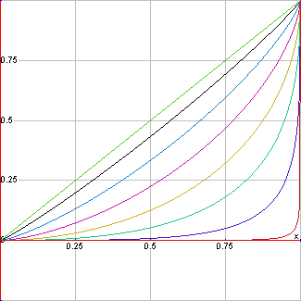
Class 5
y = (1-(1-x)^{r})^{(1/r)}
0 < r < 1
y’ = (1-(1-x)^{r})^{(1/r-1)}(1-x)^{r-1}
y’ (0) = m_{Unit} = 0
y’ (1) = n_{Unit} = ∞
The top line is y = x
for comparison
From top down, r = 10/11, 41/52, 2/3, 21/38, 9/20, 1/3, 1/5

Slide 15
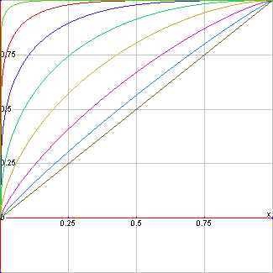
Class 6
y = (1-(1-x)^{r})^{(1/r)}
r > 1
y’ = (1-(1-x)^{r})^{(1/r-1)}(1-x)^{r-1}
y’ (0) = m_{Unit} = ∞
y’ (1) = n_{Unit} = 0
The bottom line is y = x
for comparison
From bottom up, r = 11/10, 13/10, 17/10, 19/8, 15/4, 7, 20

Slide 16
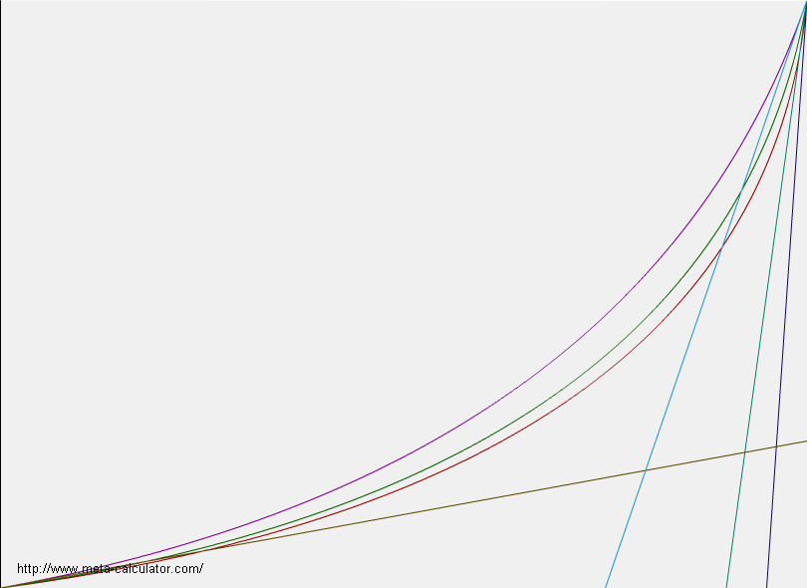
Class 7,9
y = ((1-(1-((1-1/(n+1)^2)
- (1-1/(m+1)^2))*x
- (1-1/(m+1)^2) )^.5)^2
- (1-(1-(1-1/(m+1)^2))^.5)^2)
/ ((n^2 /(n+1)^2) -(m^2 / (m+1)^2))
Class 7:
0 < m < 1 and n > 1
Class 9 is the symmetric case of Class 7:
0 < m < 1 and n =1 / m
4
10
20
.25

Slide 17
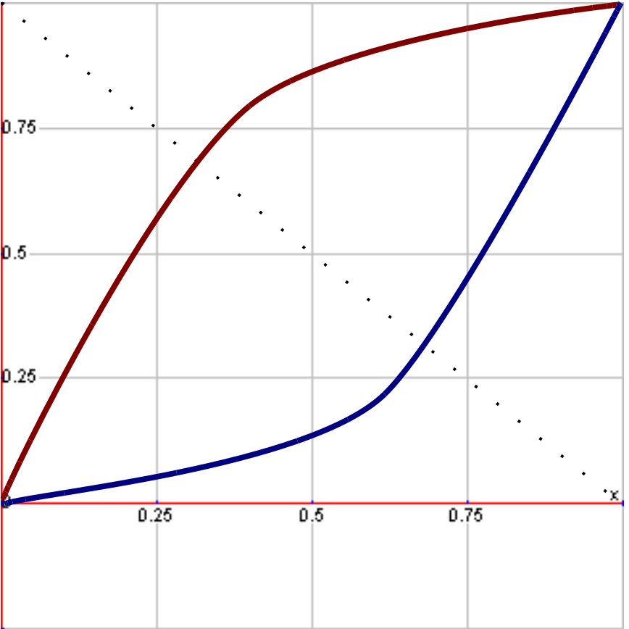
Class 9,10
I need asymmetric functions, concave up and down, that have m_{Unit} = r at x = 0 and m_{Unit} = s at x =1
*solved* see next page

Slide 18

(0 < m < 1 && n > 1 ) || (0 < n < 1 && m > 1)
(Concave Up) (Concave Down)
Y = ((1-(1-((1-1/(n+1)^2) – (1-1/(m+1)^2))*x - (1-1/(m+1)^2) )^.5)^2
- (1-(1-(1-1/(m+1)^2))^.5)^2)
/ ((n^2 / (n+1)^2) - (m^2 / (m+1)^2))
Y = ((1-(1-((1-1/(6+1)^2) – (1-1/(.25+1)^2))*x - (1-1/(.25+1)^2) )^.5)^2
- (1-(1-(1-1/(.25+1)^2))^.5)^2)
/ ((6^2 / (6+1)^2) - (.25^2 / (.25+1)^2))

Slide 19
Overall Process
Initialize system
Node placement and node ordering
Line cross check
For each node j, obtain (Δx,Δy)_{j,} future_{j,} and mLine_{j}
For each node j, obtain transformational variables L_{j} and R_{j}
For the first node, obtain past₁
For the first node, obtain mRef₁ and mUnit₁
For the first node, check appendix to obtain curve₁, nUnit₁, and nRef₁
Draw the curve from node₁ to node₂ corresponding to the equation for curve₁
Increment to node₂
------------------repeat steps 11-15 unless j > numNodes--------------------
For node j obtain past_{j}
Obtain mRef_{j} and mUnit_{j}
Check appendix to obtain curve_{j}, nUnit_{j}, and nRef_{j}
Draw the curve from node_{j} to node_{j} corresponding to the equation for curve_{j}
Increment j = j + 1

Slide 20
Initialize system
  Query size of max ±x and ±y coordinates
  Query total number of nodes (numNodes)

Slide 21
Initialize system
50
numNodes = 5
0
-50
50
-50

Slide 22
Node placement and node ordering
  Each node is assigned an (x,y) value in reference coordinate space
    Random placement
    Manual placement
  Each node is assigned an initial rank ordering

Slide 23
Node placement and node ordering
50
(20, 35)
(-35, 30)
1
5
2
(20, 15)
0
-50
50
(7, -10)
3
4
(-15, -30)
-50

Slide 24
Line cross check
  Trace a straight line between the ordered nodes to ensure that no lines cross
    If they cross:
      Change node ordering and repeat line cross check
    If they do not cross:
      Continue

Slide 25
Line cross check (failed)
50
(20, 35)
(-35, 30)
2
1
X
5
(20, 15)
X
0
-50
50
(7, -10)
3
4
(-15, -30)
-50

Slide 26
Line cross check (passed)
50
(20, 35)
(-35, 30)
1
5
2
(20, 15)
0
-50
50
(7, -10)
3
4
(-15, -30)
-50

Slide 27
For each node j, obtain (Δx,Δy)_{j,} future_{j,} and mLine_{j}
  Designate the difference in reference coordinate values between node_{j+1} and node_{j} as (Δx,Δy)_{j}
    (Δx,Δy)_{j} = (x_{j+1} – x_{j} , y_{j+1} – y_{j})
  Future_{j} is simply a qualitative tuple representing the sign of both values in (Δx,Δy)_{j}. The three possible values are 0, +, -
    future_{j} = (sign Δx_{j} , sign Δy_{j})
  Designate the slope of the line between node_{j} and node_{j+1} as mLine_{j}
    mLine_{j} = Δy_{j} / Δx_{j}

Slide 28
(Δx,Δy)_{j,} future_{j,} and mLine_{j}
50
(20, 35)
(-35, 30)
1
(Δx,Δy)₁ = (0, -20)
future₁ = (0, -)
mLine₁ = ∞
5
(Δx,Δy)₅ = (55, 5)
future₅ = (+,+)
mLine₅= 1/11
2
(20, 15)
(Δx,Δy)₂ = (-13, -25)
future₂ = ( -, -)
mLine₂ = 25/13
0
-50
50
(7, -10)
3
(Δx,Δy)₃ = (-22, -20)
future₃ = ( -, -)
mLine₃ = 10/11
4
(Δx,Δy)₄ = (-20, 60)
future₄ = ( -,+)
mLine₄ = -3
(-15, -30)
-50

Slide 29
For each node j, obtain transformational variables L_{j} and R_{j}
  Before we can pick a curve for each node, the coordinate space between node_{j} and node_{j+1} must be transformed from reference to unit systems
  L_{j} is the linear transformation parameter and corrects for stretching in the x or y directions
    L_{j} = |Δx ∕ Δy|
  R_{j} is the rotational transformation parameter and corrects for rotation of the axis around the origin
    R_{j} = 1 if future_{j} = (+,+), (+,0), ( -, -), or ( -,0)
    R_{j} = -1 if future_{j} = (+, -), (0, -), ( -,+), or (0,+)

Slide 30
Transformational variables L_{j} and R_{j}
50
(20, 35)
1
(-35, 30)
5
L₁ = 0
R₁= -1
L₅ = 11
R₅ = 1
(20, 15)
2
L₂ = 13/25
R₂ = 1
0
-50
50
(7, -10)
3
L₃ = 11/10
R₃ = 1
(-15, -30)
4
L₄ = 1/3
R₄ = -1
-50

Slide 31
Transformation from reference space to unit space visualization
(for some dumb reason, these node coordinates and node ordering are different from the previous examples – must change)
i=2
20,40
1,1
0,0
future = (+,+)
R=1
L=10/3
y
y
i=1
-30, 25
1,1
0,0
x
future = (+,-)
R=-1
L=2/11
x
future = (-,+)
R=-1
L=3/11
x
x
i=3
30,-15
1,1
0,0
i=5
-15,-30
1,1
0,0
future = (-,+)
R=-1
L=5/3
y
y
x
future = (-,-)
R=1
L=2/3
y
i=4
10,-45
1,1
0,0

Slide 32
For the first node, obtain past₁
  Past_{j} is a qualitative tuple of two values signifying which direction the curve was heading when it got to node_{j}
  The allowable values are 0, +, -
  Only node₁ gets an initial past value which is determined as follows:
    If future₁ = (+,+) then past₁ = (0,+), (+,+) or (+,0)
    = (+,0) = (+,+), (+,0) or (+, -)
    = (+, -) = (+,0), (+, -) or (0, -)
    = (0, -) = (+, -), (0, -) or ( -, -)
    = ( -, -) = (0, -), ( -, -) or ( -,0)
    = ( -,0) = ( -, -), ( -,0) or ( -,+)
    = ( -,+) = ( -,0), ( -,+) or (0,+)
    = (0,+) = ( -,+), (0,+) or (+,+)
    Choose randomly from amongst the set of three

Slide 33
Obtain past₁
50
past₁ = (+, -)
past₁ = (0, -)
past₁ = ( -, -)
(-35, 30)
1
(20, 35)
5
future₁ = (0, -)
2
(20, 15)
0
-50
50
(7, -10)
3
4
(-15, -30)
-50

Slide 34
For the first node, obtain mRef₁ and mUnit₁
  mRef_{j} designates the slope of the curve at each node_{j} in the untransformed reference coordinate frame
  mUnit_{j} designates the slope of the curve at each node_{j} in the transformed unit coordinate frame
  Only node₁ gets an initial mRef₁ value which is determined as follows:
    If past₁ = (+,+) then mRef₁ = f > 0
    = (+,0) then mRef₁ = 0
    = (+, -) then mRef₁ = f < 0
    = (0, -) then mRef₁ = ∞
    = ( -, -) then mRef₁ = f > 0
    = ( -,0) then mRef₁ = 0
    = ( -,+) then mRef₁ = f < 0
    = (0,+) then mRef₁ = ∞
    values of f are chosen randomly
  Only node₁ gets an initial mUnit₁ value which is determined as follows:
    mUnit₁ = L₁(mRef₁ / R₁)^{R1}

Slide 35
Obtain mRef₁ and mUnit₁
50
past₁ = (0, -)
mRef₁ = ∞
mUnit₁ = 0
(-35, 30)
1
y
(20, 35)
5
Blue text signifies
unit coordinate space
2
(20, 15)
x
0
-50
50
(7, -10)
3
4
(-15, -30)
-50

Slide 36
For the first node, check appendix to obtain curve₁, nUnit₁, and nRef₁
  Curve₁ is determined as follows
    There are a set of allowable curves for the previously obtained past₁ and future₁ values
    Compare mRef₁ to mLine₁ to further reduce this set of allowable curves
    If there are still multiple choices remaining in this subset, then curve₁ is chosen randomly
  The value of curve₁ automatically assigns a value to nUnit₁
  nRef₁ is determined by retransformed from the unit to reference coordinate axis as follows:
    nRef₁ = R₁(nUnit₁/L₁)^{R1}

Slide 37
Obtain curve₁, nUnit₁, and nRef₁
50
future₁= (0, -)
past₁ = (0, -)
mRef₁ = ∞
mLine₁ = ∞
R₁ = -1
L₁ = 0
curve₁ = 0
nUnit₁ = 0
nRef₁ = ∞
1
(-35, 30)
y
(20, 35)
5
2
Blue text signifies
unit coordinate space
(20, 15)
x
0
-50
50
(7, -10)
3
4
(-15, -30)
-50

Slide 38
Draw the curve from node₁ to node₂ corresponding to the equation for curve₁ as found in the appendix
Increment to node₂

Slide 39
Draw curve₁ and increment to node₂
50
1
(-35, 30)
(20, 35)
5
2
(20, 15)
0
-50
50
(7, -10)
3
4
(-15, -30)
-50

Slide 40
For node j obtain past_{j}
  Past_{j} value for node₂ … node_{numNodes} are obtained as follows:
    If nRef_{j-1} = i and future_{j-1} = (+,+) then past_{j} = (+,+)
    If nRef_{j-1} = 0 and future_{j-1} = (+,+) then past_{j} = (+,0)
    If nRef_{j-1} = ∞ and future_{j-1} = (+,+) then past_{j} = (0,+)
    If future_{j-1} = (+,0) then past_{j} = (+,0)
    If nRef_{j-1} = i and future_{j-1} = (+, -) then past_{j} = (+, -)
    If nRef_{j-1} = 0 and future_{j-1} = (+, -) then past_{j} = (+,0)
    If nRef_{j-1} = ∞ and future_{j-1} = (+, -) then past_{j} = (0, -)
    If future_{j-1} = (0, -) then past_{j} = (0, -)
    If nRef_{j-1} = i and future_{j-1} = ( -, -) then past_{j} = ( -, -)
    If nRef_{j-1} = 0 and future_{j-1} = ( -, -) then past_{j} = ( -,0)
    If nRef_{j-1} = ∞ and future_{j-1} = ( -, -) then past_{j} = (0, -)
    If future_{j-1} = (-, 0) then past_{j} = (-, 0)
    If nRef_{j-1} = i and future_{j-1} = ( -,+) then past_{j} = ( -,+)
    If nRef_{j-1} = 0 and future_{j-1} = ( -,+) then past_{j} = ( -,0)
    If nRef_{j-1} = ∞ and future_{j-1} = ( -,+) then past_{j} = (0, +)
    If future_{j-1} = (0,+) then past_{j} = (0, +)

Slide 41
Obtain past₂
50
(20, 35)
nRef₁ = ∞
future₁ = (0, -)
past₂ = (0, -)
(-35, 30)
1
5
2
(20, 15)
0
-50
50
(7, -10)
3
4
(-15, -30)
-50

Slide 42
Obtain mRef_{j} and mUnit_{j}
  mRef_{j} is determined as follows:
    mRef_{j} = nRef_{j-1}
  mUnit_{j} is determined as follows:
    mUnit_{j} = L_{j}(mRef_{j} / R_{j})^{Rj}

Slide 43
Obtain mRef₂ and mUnit₂
50
(20, 35)
₁n_{Ref} = ∞
₂m_{ref} = ∞
₂m_{Unit} = ∞
(-35, 30)
1
5
x
2
(20, 15)
Blue text signifies
unit coordinate space
0
-50
50
y
3
(7, -10)
4
(-15, -30)
-50

Slide 44
Check appendix to obtain curve_{j}, nUnit_{j}, and nRef_{j}
  Curve_{j} is determined as follows
    There are a set of allowable curves for the previously obtained past_{j} and future_{j} values
    Compare mRef_{j} to mLine_{j} to further reduce this set of allowable curves
    If there are still multiple choices remaining in this subset, then curve₁ is chosen randomly
  The value of curve_{j} automatically assigns a value to nUnit_{j}
  nRef_{j} is determined by retransformed from the unit to reference coordinate axis as follows:
    nRef_{j} = R_{j}(nUnit_{j}/L_{j})^{Rj}

Slide 45
Draw the curve from node_{j} to node_{j+1} corresponding to the equation for curve_{j} as found in the appendix
Increment to node_{j+1}

Slide 46
Obtain curve₂, nUnit₂, and nRef₂
Draw curve₂ and increment to node₃
50
past₂ = (0, -)
future₂ = (-, -)
mLine₂ = 25/13
mRef₂ = ∞
mUnit₂ = ∞
L₂ =13/25
R₂ = 1
curve₂ = 2 (or 6) <random>
nUnit₂ = 2/5 <random>
nRef₂ = 10/13
(20, 35)
(-35, 30)
1
5
x
(20, 15)
2
Blue text signifies
unit coordinate space
0
-50
50
(7, -10)
y
3
4
(-15, -30)
-50

Slide 47
Obtain past₃
Obtain mRef₃ and mUnit₃
Obtain curve₃, nUnit₃, and nRef₃
Draw curve₃ and increment to node₄
50
nRef₂ = 10/13
future₂ = (-, -)
future₃ = (-, -)
mLine₃ = 10/11
L₃ =11/10
R₃ = 1
past₃ = (-, -)
mRef₃ = 10/13
mUnit₃ = 11/13
class₃ = 7 (or 3, 9)
nUnit₃ = 13/11
nRef₃ = 130/121
(20, 35)
1
5
(-35, 30)
2
(20, 15)
0
-50
50
(7, -10)
3
4
(-15, -30)
-50

Slide 48
Obtain past₄
Obtain mRef₄ and mUnit₄
Insert Node and obtain curve₄ and nRef₄
Draw curve₄
Update rank ordering to include new node
Obtain (Δx,Δy)_{j,} future_{j,}, mLine_{j}, L_{j} and R_{j} for new node
Increment to new node₅
50
nRef₃ = 130/121
future₃ = (-, -)
future₄ = (-, +)
mLine₄ = -3
L₄ =1/3
R₄ = -1
past₄ = (-, -)
mRef₄ = 130/121
mUnit₄ = -121/390
Insert Node
curve₄ = 4
nRef₄ = 0
(20, 35)
1
6
(-35, 30)
2
(20, 15)
0
-50
50
(7, -10)
3
4
Node_{New=5}
(-15, -30)
-50

Slide 49
APPENDIX

Slide 50
Past = (+,+)

Slide 51
class check
past = (+,+)
future = (+,+)
50
f = m_{line}
class:
0 n_{Ref} = m_{Line}
f > m_{line}
class:
4 n_{Ref} = 0
8 n_{Ref} = 1 / L²m_{Ref}
10 n_{Ref} = i <random>
node i
-50
m_{ref} = f
50
f < m_{line}
class:
3 n_{Ref} = ∞
7 n_{Ref} = 1 / L²m_{Ref}
9 n_{Ref} = i <random>
-50

Slide 52
class check
past = (+,+)
future = (+,0)
Node insertion anywhere in the shaded region followed by
a class 4 unit function
50
Node_{New}
Class 4
n_{Ref} =0
m_{Ref}=f
Node A
Node B
-50
50
Quick Corner Regime
A Permitted Unit Function check is subsequently performed after Node Insertion
past = (+,0)
future = (+,-)
-50

Slide 53
class check
past = (+,+)
future = (+,-)
Node insertion anywhere in the shaded region followed by
a class 4 unit function
50
Node_{New}
Class 4
n_{Ref} =0
m_{Ref}=f
Node A
-50
50
Quick Corner Regime
A Permitted Unit Function check is subsequently performed after Node Insertion
past = (+,0)
future = (+,-)
Node B
-50

Slide 54
class check
past = (+,+)
future = (0,-)
Node insertion anywhere in the shaded region followed by
a class 4 unit function
50
Node_{New}
Class 4
n_{Ref} =0
m_{Ref}=f
Node A
-50
50
Quick Corner Regime
A Permitted Unit Function check is subsequently performed after Node Insertion
past = (+,0)
future = (-,-)
Node B
-50

Slide 55
class check
past = (+,+)
future = (-,-)
Type A
(Future node is beneath past trajectory)
Node insertion anywhere in the shaded region followed by
a class 4 unit function
50
Node_{New}
Class 4
n_{Ref} =0
m_{Ref}=f
Node A
-50
50
Node B
Quick Corner Regime
A Permitted Unit Function check is subsequently performed after Node Insertion
past = (+,0)
future = (-,-)
-50

Slide 56
class check
past = (+,+)
future = (-,-)
Type B
(Future node is above past trajectory)
Node insertion anywhere in the shaded region followed by
a class 3 unit function
50
Node_{New}
Class 3
n_{Ref} = ∞
Node A
m_{Ref}=f
-50
50
Node B
Quick Corner Regime
A Permitted Unit Function check is subsequently performed after Node Insertion
past = (0,+)
future = (-,-)
-50

Slide 57
class check
past = (+,+)
future = (-,0)
Node insertion anywhere in the shaded region followed by
a class 3 unit function
50
Node_{New}
Class 3
n_{Ref} = ∞
Node B
Node A
m_{Ref}=f
-50
50
Quick Corner Regime
A Permitted Unit Function check is subsequently performed after Node Insertion
past = (0,+)
future = (-,-)
-50

Slide 58
class check
past = (+,+)
future = (-,+)
Node insertion anywhere in the shaded region followed by
a class 3 unit function
50
Node B
Node_{New}
Class 3
n_{Ref} = ∞
Quick Corner Regime
Node A
m_{Ref}=f
-50
50
A Permitted Unit Function check is subsequently performed after Node Insertion
past = (0,+)
future = (-,+)
-50

Slide 59
class check
past = (+,+)
future = (0,+)
Node insertion anywhere in the shaded region followed by
a class 3 unit function
50
Node B
Node_{New}
Class 3
n_{Ref} = ∞
Quick Corner Regime
Node A
m_{Ref}=f
-50
50
Quick Corner Regime
A Permitted Unit Function check is subsequently performed after Node Insertion
past = (0,+)
future = (-,+)
-50

Slide 60
Past = (+,0)

Slide 61
class check
past = (+,0)
future = (+,0)
Insert a straight line
50
m_{Ref} =0
n_{Ref} =0
-50
Node A
Node B
50
-50

Slide 62
class check
past = (+,0)
future = (+,-)
Rotate frame of reference 90º counter clockwise
50
m_{Ref} = 0
-50
Node A
Class 6
n_{Ref} =∞
50
Class 2
n_{Ref} = i
Node B
-50

Slide 63
class check
past = (+,0)
future = (0,-)
Rotate frame of reference 90º counter clockwise
Node insertion anywhere in the shaded region followed by
a class 6 unit function
50
m_{Ref} = 0
-50
Node A
50
Node_{New}
Class 6
n_{Ref} = ∞
A Permitted Unit Function check is subsequently performed after Node Insertion
past = (0,-)
future = (-,-)
Node B
Quick Corner Regime
-50

Slide 64
class check
past = (+,0)
future = (-,-)
Rotate frame of reference 90º counter clockwise
Node insertion anywhere in the shaded region followed by
a class 6 unit function
50
m_{Ref} = 0
-50
Node A
50
Node_{New}
Class 6
n_{Ref} = ∞
A Permitted Unit Function check is subsequently performed after Node Insertion
past = (0,-)
future = (-,-)
Node B
Quick Corner Regime
-50

Slide 65
class check
past = (+,0)
future = (-,0)
Type A
(Future node is beneath past trajectory)
Rotate frame of reference 90º counter clockwise
Node insertion anywhere in the shaded region followed by
a class 6 unit function
50
m_{Ref} = 0
-50
Node B
Node A
50
Node_{New}
Class 6
n_{Ref} = ∞
A Permitted Unit Function check is subsequently performed after Node Insertion
past = (0,-)
future = (-,+)
Quick Corner Regime
-50

Slide 66
class check
past = (+,0)
future = (-,0)
Type B
(Future node is above past trajectory)
Node insertion anywhere in the shaded region followed by
a class 5 unit function
50
Quick Corner Regime
Node_{New}
Class 5
n_{Ref} = ∞
-50
Node B
Node A
m_{Ref} = 0
50
A Permitted Unit Function check is subsequently performed after Node Insertion
past = (0,+)
future = (-,-)
-50

Slide 67
class check
past = (+,0)
future = (-,+)
Node insertion anywhere in the shaded region followed by
a class 5 unit function
50
Quick Corner Regime
Node B
Node_{New}
Class 5
n_{Ref} = ∞
-50
Node A
m_{Ref} = 0
50
A Permitted Unit Function check is subsequently performed after Node Insertion
past = (0,+)
future = (-,+)
-50

Slide 68
class check
past = (+,0)
future = (0,+)
Node insertion anywhere in the shaded region followed by
a class 5 unit function
50
Quick Corner Regime
Node B
Node_{New}
Class 5
n_{Ref} = ∞
-50
Node A
m_{Ref} = 0
50
A Permitted Unit Function check is subsequently performed after Node Insertion
past = (0,+)
future = (-,+)
-50

Slide 69
class check
past = (+,0)
future = (+,+)
Node insertion anywhere in the shaded region followed by
a class 5 unit function
50
Node B
Class 1
n_{Ref} = i
Class 5
n_{Ref} =∞
-50
Node A
m_{Ref} = 0
50
-50

Slide 70
Past = (+,-)

Slide 71
class check
past = (+,-)
future = (+,-)
Rotate frame of reference 90º counter clockwise
50
f > m_{line}
class (random):
4 n_{Ref} = ∞
8 n_{Ref} = L² / m_{Ref}
10 n_{Ref} = i (random)
m_{Ref} = f
-50
Node A
50
f < m_{line}
class (random):
3 n_{Ref} = 0
7 n_{Ref} = L² / m_{Ref}
9 n_{Ref} = i (random)
Node B
f = m_{line}
class:
0 n_{Ref} = m_{Line}
-50

Slide 72
class check
past = (+,-)
future = (0,-)
Rotate frame of reference 90º counter clockwise
Node insertion anywhere in the shaded region followed by
a class 4 unit function
50
A Permitted Unit Function check is subsequently performed after Node Insertion
past = (0,-)
future = (-,-)
m_{Ref} = f
-50
Node A
Quick Corner Regime
50
Node_{New}
Class 4
n_{Ref} = ∞
Node B
-50

Slide 73
class check
past = (+,-)
future = (-,-)
Rotate frame of reference 90º counter clockwise
Node insertion anywhere in the shaded region followed by
a class 4 unit function
50
A Permitted Unit Function check is subsequently performed after Node Insertion
past = (0,-)
future = (-,-)
m_{Ref} = f
-50
Node A
Quick Corner Regime
50
Node_{New}
Class 4
n_{Ref} = ∞
Node B
-50

Slide 74
class check
past = (+,-)
future = (-,0)
Rotate frame of reference 90º counter clockwise
Node insertion anywhere in the shaded region followed by
a class 4 unit function
50
A Permitted Unit Function check is subsequently performed after Node Insertion
past = (0,-)
future = (-,+)
m_{Ref} = f
-50
Node B
Node A
Quick Corner Regime
50
Node_{New}
Class 4
n_{Ref} = ∞
-50

Slide 75
class check
past = (+,-)
future = (-,+)
Type A
(Future node is beneath past trajectory)
Rotate frame of reference 90º counter clockwise
Node insertion anywhere in the shaded region followed by
a class 4 unit function
50
A Permitted Unit Function check is subsequently performed after Node Insertion
past = (0,-)
future = (-,+)
Node B
m_{Ref} = f
-50
Node A
Quick Corner Regime
50
Node_{New}
Class 4
n_{Ref} = ∞
-50

Slide 76
class check
past = (+,-)
future = (-,+)
Type B
(Future node is above past trajectory)
Rotate frame of reference 90º counter clockwise
Node insertion anywhere in the shaded region followed by
a class 3 unit function
50
A Permitted Unit Function check is subsequently performed after Node Insertion
past = (+,0)
future = (-,+)
Node B
m_{Ref} = f
-50
Node A
50
Node_{New}
Class 3
n_{Ref} = 0
Quick Corner Regime
-50

Slide 77
class check
past = (+,-)
future = (0,+)
Rotate frame of reference 90º counter clockwise
Node insertion anywhere in the shaded region followed by
a class 3 unit function
50
A Permitted Unit Function check is subsequently performed after Node Insertion
past = (+,0)
future = (-,+)
Node B
m_{Ref} = f
-50
Node A
50
Node_{New}
Class 3
n_{Ref} = 0
Quick Corner Regime
-50

Slide 78
class check
past = (+,-)
future = (+,+)
Rotate frame of reference 90º counter clockwise
Node insertion anywhere in the shaded region followed by
a class 3 unit function
50
A Permitted Unit Function check is subsequently performed after Node Insertion
past = (+,0)
future = (+,+)
Node B
m_{Ref} = f
-50
Node A
50
Node_{New}
Class 3
n_{Ref} = 0
Quick Corner Regime
-50

Slide 79
class check
past = (+,-)
future = (+,0)
Rotate frame of reference 90º counter clockwise
Node insertion anywhere in the shaded region followed by
a class 3 unit function
50
A Permitted Unit Function check is subsequently performed after Node Insertion
past = (+,0)
future = (+,+)
m_{Ref} = f
Node B
-50
Node A
50
Node_{New}
Class 3
n_{Ref} = 0
Quick Corner Regime
-50

Slide 80
Past = (0,-)

Slide 81
class check
past = (0,-)
future = (0,-)
Rotate frame of reference 90º counter clockwise
Insert a straight line
50
m_{Ref} = ∞
-50
Node A
50
Node B
n_{Ref} = ∞
-50

Slide 82
class check
past = (0,-)
future = (-,-)
Rotate frame of reference 180º
50
m_{Ref} = ∞
-50
Node A
50
Class 2
n_{Ref} = i (random)
Node B
Class 6
n_{Ref} = 0
-50

Slide 83
class check
past = (0,-)
future = (-,0)
Rotate frame of reference 180º
Node insertion anywhere in the shaded region followed by
a class 6 unit function
50
A Permitted Unit Function check is subsequently performed after Node Insertion
past = (-,0)
future = (-,+)
Node B
m_{Ref} = ∞
-50
Node A
50
Node_{New}
Class 6
n_{Ref} = 0
Quick Corner Regime
-50

Slide 84
class check
past = (0,-)
future = (-,+)
Rotate frame of reference 180º
Node insertion anywhere in the shaded region followed by
a class 6 unit function
50
A Permitted Unit Function check is subsequently performed after Node Insertion
past = (-,0)
future = (-,+)
Node B
m_{Ref} = ∞
-50
Node A
50
Node_{New}
Class 6
n_{Ref} = 0
Quick Corner Regime
-50

Slide 85
class check
past = (0,-)
future = (0,+)
Type A
(node is to the left of past trajectory)
Rotate frame of reference 180º
Node insertion anywhere in the shaded region followed by
a class 6 unit function
50
A Permitted Unit Function check is subsequently performed after Node Insertion
past = (-,0)
future = (+,+)
Node B
m_{Ref} = ∞
Node A
-50
50
Node_{New}
Class 6
n_{Ref} = 0
Quick Corner Regime
-50

Slide 86
class check
past = (0,-)
future = (0,+)
Type B
(node is to the right of past trajectory)
Rotate frame of reference 90º clockwise
Node insertion anywhere in the shaded region followed by
a class 5 unit function
50
A Permitted Unit Function check is subsequently performed after Node Insertion
past = (+,0)
future = (-,+)
Node B
m_{Ref} = ∞
Node A
-50
50
Node_{New}
Class 5
n_{Ref} = 0
Quick Corner Regime
-50

Slide 87
class check
past = (0,-)
future = (+,+)
Rotate frame of reference 90º clockwise
Node insertion anywhere in the shaded region followed by
a class 5 unit function
50
A Permitted Unit Function check is subsequently performed after Node Insertion
past = (+,0)
future = (+,+)
Node B
m_{Ref} = ∞
Node A
-50
50
Node_{New}
Class 5
n_{Ref} = 0
Quick Corner Regime
-50

Slide 88
class check
past = (0,-)
future = (+,0)
Rotate frame of reference 90º clockwise
Node insertion anywhere in the shaded region followed by
a class 5 unit function
50
A Permitted Unit Function check is subsequently performed after Node Insertion
past = (+,0)
future = (+,+)
m_{Ref} = ∞
Node A
Node B
-50
50
Node_{New}
Class 5
n_{Ref} = 0
Quick Corner Regime
-50

Slide 89
class check
past = (0,-)
future = (+,-)
Rotate frame of reference 90º clockwise
50
m_{Ref} = ∞
Node A
-50
Class 1
n_{Ref} = i (random)
50
Node B
Class 5
n_{Ref} = 0
-50

Slide 90
Past = (-,-)

Slide 91
class check
past = (-,-)
future = (-,-)
Rotate frame of reference 180º
50
f < m_{line}
class (random):
3 n_{Ref} = 0
7 n_{Ref} = L² / m_{Ref}
9 n_{Ref} = i (random)
m_{Ref} = f
-50
Node A
50
Node B
f > m_{line}
class (random):
4 n_{Ref} = ∞
8 n_{Ref} = L² / m_{Ref}
10 n_{Ref} = i (random)
f = m_{line}
class:
0 n_{Ref} = m_{Line}
-50

Slide 92
class check
past = (-,-)
future = (-,0)
Rotate frame of reference 180º
Node insertion anywhere in the shaded region followed by
a class 4 unit function
50
A Permitted Unit Function check is subsequently performed after Node Insertion
past = (-,0)
future = (-,+)
Node B
m_{Ref} = f
-50
Node A
50
Quick Corner Regime
Node_{New}
Class 4
n_{Ref} = 0
-50

Slide 93
class check
past = (-,-)
future = (-,+)
Rotate frame of reference 180º
Node insertion anywhere in the shaded region followed by
a class 4 unit function
50
A Permitted Unit Function check is subsequently performed after Node Insertion
past = (-,0)
future = (-,+)
Node B
m_{Ref} = f
-50
Node A
50
Quick Corner Regime
Node_{New}
Class 4
n_{Ref} = 0
-50

Slide 94
class check
past = (-,-)
future = (0,+)
Rotate frame of reference 180º
Node insertion anywhere in the shaded region followed by
a class 4 unit function
50
A Permitted Unit Function check is subsequently performed after Node Insertion
past = (-,0)
future = (+,+)
Node B
m_{Ref} = f
-50
Node A
50
Node_{New}
Class 4
n_{Ref} = 0
Quick Corner Regime
-50

Slide 95
class check
past = (-,-)
future = (+,+)
Type A
(node is to the left of past trajectory)
Rotate frame of reference 180º
Node insertion anywhere in the shaded region followed by
a class 4 unit function
50
A Permitted Unit Function check is subsequently performed after Node Insertion
past = (-,0)
future = (+,+)
Node B
m_{Ref} = f
-50
Node A
50
Node_{New}
Class 4
n_{Ref} = 0
Quick Corner Regime
-50

Slide 96
class check
past = (-,-)
future = (+,+)
Type B
(node is to the right of past trajectory)
Rotate frame of reference 180º
Node insertion anywhere in the shaded region followed by
a class 3 unit function
50
A Permitted Unit Function check is subsequently performed after Node Insertion
past = (0,-)
future = (+,+)
Node B
m_{Ref} = f
-50
Node A
50
Quick Corner Regime
Node_{New}
Class 3
n_{Ref} = ∞
-50

Slide 97
class check
past = (-,-)
future = (+,0)
Rotate frame of reference 180º
Node insertion anywhere in the shaded region followed by
a class 3 unit function
50
A Permitted Unit Function check is subsequently performed after Node Insertion
past = (0,-)
future = (+,+)
m_{Ref} = f
Node B
-50
Node A
50
Quick Corner Regime
Node_{New}
Class 3
n_{Ref} = ∞
-50

Slide 98
class check
past = (-,-)
future = (+,-)
Rotate frame of reference 180º
Node insertion anywhere in the shaded region followed by
a class 3 unit function
50
A Permitted Unit Function check is subsequently performed after Node Insertion
past = (0,-)
future = (+,-)
m_{Ref} = f
-50
Node A
50
Node_{New}
Class 3
n_{Ref} = ∞
Quick Corner Regime
Node B
-50

Slide 99
class check
past = (-,-)
future = (0,-)
Rotate frame of reference 180º
Node insertion anywhere in the shaded region followed by
a class 3 unit function
50
A Permitted Unit Function check is subsequently performed after Node Insertion
past = (0,-)
future = (+,-)
m_{Ref} = f
-50
Node A
50
Node_{New}
Class 3
n_{Ref} = ∞
Quick Corner Regime
Node B
-50

Slide 100
Past = (-,0)

Slide 101
class check
past = (-,0)
future = (-,0)
Insert a straight line
50
n_{Ref} = 0
m_{Ref} = 0
-50
Node B
Node A
50
-50

Slide 102
class check
past = (-,0)
future = (-,+)
Rotate frame of reference 90º clockwise
50
Class 2
n_{Ref} = i (random)
Class 6
n_{Ref} = ∞
Node B
m_{Ref} = 0
-50
Node A
50
-50

Slide 103
class check
past = (-,0)
future = (0,+)
Rotate frame of reference 90º clockwise
50
Node B
Quick Corner Regime
Node_{New}
Class 6
n_{Ref} = ∞
m_{Ref} = 0
-50
Node A
50
A Permitted Unit Function check is subsequently performed after Node Insertion
past = (0,+)
future = (+,+)
Node insertion anywhere in the shaded region followed by a class 6 unit function
-50

Slide 104
class check
past = (-,0)
future = (+,+)
Rotate frame of reference 90º clockwise
50
Node B
Quick Corner Regime
Node_{New}
Class 6
n_{Ref} = ∞
m_{Ref} = 0
-50
Node A
50
A Permitted Unit Function check is subsequently performed after Node Insertion
past = (0,+)
future = (+,+)
Node insertion anywhere in the shaded region followed by a class 6 unit function
-50

Slide 105
50
Quick Corner Regime
Node_{New}
Class 6
n_{Ref} = ∞
Node B
-50
m_{Ref} = 0
Node A
50
class check
past = (-,0)
future = (+,0)
Type A
(Node is above the past trajectory)
Rotate frame of reference 90º clockwise
Node insertion anywhere in the shaded region followed by a class 6 unit function
A Permitted Unit Function check is subsequently performed after Node Insertion
past = (0,+)
future = (+,-)
-50

Slide 106
class check
past = (-,0)
future = (+,0)
Type B
(Node is below the past trajectory)
Rotate frame of reference 180º
Node insertion anywhere in the shaded region followed by a class 5 unit function
50
Quick Corner Regime
m_{Ref} = 0
Node B
-50
Node A
50
Node_{New}
Class 5
n_{Ref} = ∞
A Permitted Unit Function check is subsequently performed after Node Insertion
past = (0,-)
future = (+,+)
-50

Slide 107
class check
past = (-,0)
future = (+,-)
Rotate frame of reference 180º
Node insertion anywhere in the shaded region followed by a class 5 unit function
50
A Permitted Unit Function check is subsequently performed after Node Insertion
past = (0,-)
future = (+,-)
m_{Ref} = 0
Node A
-50
50
Node_{New}
Class 5
n_{Ref} = ∞
Quick Corner Regime
Node B
-50

Slide 108
class check
past = (-,0)
future = (0,-)
Rotate frame of reference 180º
Node insertion anywhere in the shaded region followed by a class 5 unit function
50
A Permitted Unit Function check is subsequently performed after Node Insertion
past = (0,-)
future = (+,-)
m_{Ref} = 0
Node A
-50
50
Node_{New}
Class 5
n_{Ref} = ∞
Quick Corner Regime
Node B
-50

Slide 109
class check
past = (-,0)
future = (-,-)
Rotate frame of reference 180º
Node insertion anywhere in the shaded region followed by a class 5 unit function
50
m_{Ref} = 0
Node A
-50
50
Class 5
n_{Ref} = ∞
Class 1
n_{Ref} = i
(random)
Node B
-50

Slide 110
Past = (-,+)

Slide 111
class check
past = (-,+)
future = (-,+)
Rotate frame of 90º clockwise
50
f < m_{line}
class:
4 n_{Ref} = 0
8 n_{Ref} = L² / m_{Ref}
10 n_{Ref} = i <random>
Node B
f = m_{line}
class:
0 n_{Ref} = m_{Line}
Node A
-50
m_{Ref} = f
50
f > m_{line}
class:
3 n_{Ref} = ∞
7 n_{Ref} = L² / m_{Ref}
9 n_{Ref} = i <random>
-50

Slide 112
50
Node_{New}
Class 4
n_{Ref} = ∞
Node B
Quick Corner Regime
Node A
-50
m_{Ref} = f
50
class check
past = (-,+)
future = (0,+)
Rotate frame of 90º clockwise
Node insertion anywhere in the shaded region followed by a class 4 unit function
A Permitted Unit Function check is subsequently performed after Node Insertion
past = (0,+)
future = (+,+)
-50

Slide 113
50
Node_{New}
Class 4
n_{Ref} = ∞
Node B
Quick Corner Regime
Node A
-50
m_{Ref} = f
50
class check
past = (-,+)
future = (+,+)
Rotate frame of 90º clockwise
Node insertion anywhere in the shaded region followed by a class 4 unit function
A Permitted Unit Function check is subsequently performed after Node Insertion
past = (0,+)
future = (+,+)
-50

Slide 114
50
Node_{New}
Class 4
n_{Ref} = ∞
Quick Corner Regime
-50
Node A
Node B
50
m_{Ref} = f
class check
past = (-,+)
future = (+,0)
Rotate frame of 90º clockwise
Node insertion anywhere in the shaded region followed by a class 4 unit function
A Permitted Unit Function check is subsequently performed after Node Insertion
past = (0,+)
future = (+,-)
-50

Slide 115
50
Node_{New}
Class 4
n_{Ref} = ∞
Quick Corner Regime
-50
Node A
Node B
50
m_{Ref} = f
class check
past = (-,+)
future = (+,-)
Type A
(Node is above past trajectory)
Rotate frame of 90º clockwise
Node insertion anywhere in the shaded region followed by a class 4 unit function
A Permitted Unit Function check is subsequently performed after Node Insertion
past = (0,+)
future = (+,-)
-50

Slide 116
50
Node_{New}
Class 3
n_{Ref} = 0
Quick Corner Regime
-50
Node A
50
m_{Ref} = f
Node B
class check
past = (-,+)
future = (+,-)
Type B
(Node is below past trajectory)
Rotate frame of 90º clockwise
Node insertion anywhere in the shaded region followed by a class 3 unit function
A Permitted Unit Function check is subsequently performed after Node Insertion
past = (-,0)
future = (+,-)
-50

Slide 117
50
Node_{New}
Class 3
n_{Ref} = 0
Quick Corner Regime
-50
Node A
50
m_{Ref} = f
class check
past = (-,+)
future = (0,-)
Rotate frame of 90º clockwise
Node insertion anywhere in the shaded region followed by a class 3 unit function
A Permitted Unit Function check is subsequently performed after Node Insertion
past = (-,0)
future = (+,-)
Node B
-50

Slide 118
50
Node_{New}
Class 3
n_{Ref} = 0
Quick Corner Regime
-50
Node A
50
m_{Ref} = f
class check
past = (-,+)
future = (-,-)
Rotate frame of 90º clockwise
Node insertion anywhere in the shaded region followed by a class 3 unit function
A Permitted Unit Function check is subsequently performed after Node Insertion
past = (-,0)
future = (-,-)
Node B
-50

Slide 119
50
Node_{New}
Class 3
n_{Ref} = 0
Quick Corner Regime
-50
Node B
Node A
50
m_{Ref} = f
class check
past = (-,+)
future = (-,0)
Rotate frame of 90º clockwise
Node insertion anywhere in the shaded region followed by a class 3 unit function
A Permitted Unit Function check is subsequently performed after Node Insertion
past = (-,0)
future = (-,-)
-50

Slide 120
Past = (0,+)

Slide 121
class check
past = (0,+)
future = (0,+)
Insert a straight line
50
Node B
n_{Ref} = ∞
m_{Ref} = ∞
-50
Node A
50
-50

Slide 122
class check
past = (0,+)
future = (+,+)
50
Class 6
n_{Ref} = 0
Node B
Class 2
n_{Ref} = i (random)
m_{Ref} = ∞
-50
Node A
50
-50

Slide 123
class check
past = (0,+)
future = (+,0)
Node insertion anywhere in the shaded region followed by a class 6 unit function
50
Node_{New}
Class 6
n_{Ref} = 0
m_{Ref} = ∞
-50
Node A
Node B
50
A Permitted Unit Function check is subsequently performed after Node Insertion
past = (+,0)
future = (+,-)
Quick Corner Regime
-50

Slide 124
class check
past = (0,+)
future = (+,-)
Node insertion anywhere in the shaded region followed by a class 6 unit function
50
Node_{New}
Class 6
n_{Ref} = 0
m_{Ref} = ∞
-50
Node A
50
A Permitted Unit Function check is subsequently performed after Node Insertion
past = (+,0)
future = (+,-)
Node B
Quick Corner Regime
-50

Slide 125
class check
past = (0,+)
future = (0,-)
Type A
(node is the right of the past trajectory)
Node insertion anywhere in the shaded region followed by a class 6 unit function
50
Node_{New}
Class 6
n_{Ref} = 0
m_{Ref} = ∞
-50
Node A
50
A Permitted Unit Function check is subsequently performed after Node Insertion
past = (+,0)
future = (-,-)
Quick Corner Regime
Node B
-50

Slide 126
50
class check
past = (0,+)
future = (0,-)
Type B
(node is the left of the past trajectory)
Rotate frame of reference 90º clockwise
Node insertion anywhere in the shaded region followed by a class 5 unit function
Node_{New}
Class 5
n_{Ref} = 0
m_{Ref} = ∞
Quick Corner Regime
-50
Node A
50
A Permitted Unit Function check is subsequently performed after Node Insertion
past = (-,0)
future = (+,-)
Node B
-50

Slide 127
class check
past = (0,+)
future = (-,-)
Rotate frame of reference 90º clockwise
Node insertion anywhere in the shaded region followed by a class 5 unit function
50
Node_{New}
Class 5
n_{Ref} = 0
m_{Ref} = ∞
Quick Corner Regime
-50
Node A
50
Node B
A Permitted Unit Function check is subsequently performed after Node Insertion
past = (-,0)
future = (-,-)
-50

Slide 128
class check
past = (0,+)
future = (-,0)
Rotate frame of reference 90º clockwise
Node insertion anywhere in the shaded region followed by a class 5 unit function
50
Node_{New}
Class 5
n_{Ref} = 0
m_{Ref} = ∞
Quick Corner Regime
-50
Node B
Node A
50
A Permitted Unit Function check is subsequently performed after Node Insertion
past = (-,0)
future = (-,-)
-50

Slide 129
class check
past = (0,+)
future = (-,+)
Rotate frame of reference 90º clockwise
50
Class 5
n_{Ref} = 0
Node B
Class 1
n_{Ref} = i (random)
m_{Ref} = ∞
-50
Node A
50
-50

Slide 130
def curve_equation(index, x, y, delta_x, delta_y, l_transform, r_transform, m_unit, n_unit, curve_type):
n_ref = r_transform[index] * (n_unit / l_transform[index]) ** r_transform[index]
m_ref = r_transform[index] * (m_unit / l_transform[index]) ** r_transform[index]
a = np.linspace(x[index], x[index + 1], 1000)
if curve_type == 1 or curve_type ==2:
b = y[index] + delta_y[index] * ((a-x[index]) / delta_x[index]) ** n_ref
elif curve_type == 3 or curve_type == 4:
b = y[index] + delta_y[index] * (1-(1-(a - x[index]) / delta_x[index]) ** m_ref)
elif curve_type == 5 or curve_type == 6:
b = y[index] + delta_y[index] * (1-(1-(a - x[index]) / delta_x[index]) ** m_ref)**(1/m_ref)
elif curve_type == 7 or curve_type == 8:
denominator =((n_ref**2/(n_ref+1)**2)-(m_ref**2/(m_ref+1)**2))
b = y[index] + delta_y[index] * ((1-(1-((1-1/(n_ref+1)**2) - (1-1/(m_ref+1)**2))
* ((a - x[index]) / delta_x[index])-(1-1/(m_ref+1)**2))**.5)**2
- (1-(1-(1-1/(m_ref+1)**2))**.5)**2) / denominator
return a,b

Slide 131
50
(x, y) _{j+1}
(x, y) _{j}
-50
50
future = (+,+)
Class 1,2: y= y_{j}+Δy_{j}((x-x_{j})/Δx_{j})^{(jnunit)}
Class 3,4: y= y_{j}+Δy_{j}(1-(1-(x-x_{j})/Δx_{j})^{(jmunit)})
Class 5,6: y= y_{j}+Δy_{j}(1-(1-(x-x_{j})/Δx_{j})^{f})^{(1/f)}

Slide 132
50
y=x²
y=1+(6(x-1)/9)²
(10,7)
(x, y) _{j+1}
(1,1)
(x, y) _{j}
-50
50
future = (+,+)
Class 1,2: y= y_{j}+Δy_{j}((x-x_{j})/Δx_{j})^{(jnunit)}

Slide 133
Class 7 and 8 Equation Research
¼ circle method
Class 5/6 transformation: (r > 1 : concave up)
y = (1-(1-x)^{1/r})^{r}
y’ = (1-(1-x)^{(1/r)})^{(r-1)}(1-x)^{(1/r} ⁻¹⁾
r=2
y = (1-(1-x)^{.5})²
y’ = (1-(1-x)^{.5})(1-x)^{-.5}
y’ = 1/s at x = (1+2s / (s+1)²
y’ = s at x = ((s+1)² -1) / (s+1)²
y’ = .5 at x= 5/9
y’ = 2 at x = 8/9

Slide 134
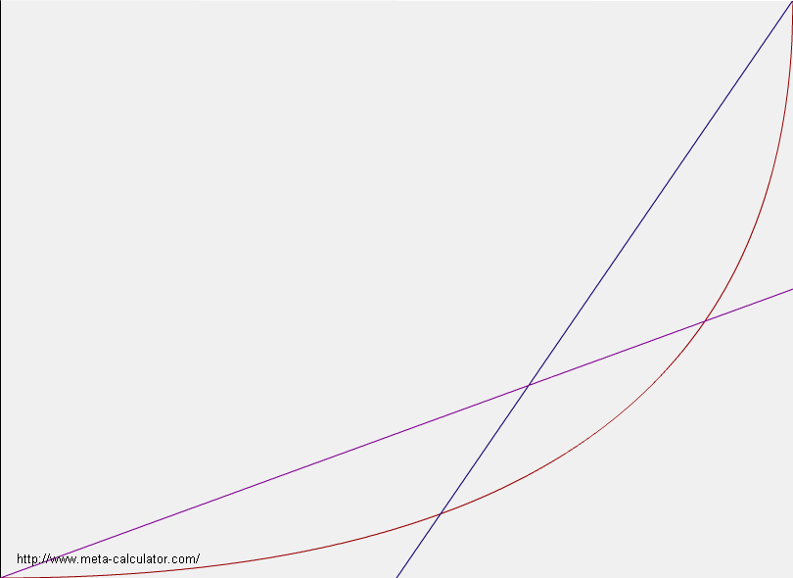
Class 7 and 8 Equation Research
¼ circle method
The segment of the
circle curve bounded
between x = 5/9 and 8/9
has a slope of ½ and 2
at those boundaries.
Can those boundaries be
transformed to (0,0) and (1,1)?
What will the resulting slopes be after
transformation? Should the
transformation rule be Implemented
with the reciprocal slopes as the
objective? In other words, instead
of plugging in the boundaries and
getting the slopes, it would be better to
plug in the desired slopes and get the
boundaries…
y =2x-1
y = (1-(1-x)^{.5})²
y =.5x
(5/9, 1/9)
8/9, 4/9)

Slide 135
Class 7 and 8 Equation Research
¼ circle method
I need this TRANSFORMATION
(5/9, 1/9)
8/9, 4/9)

Slide 136
Class 7 and 8 Equation Research
¼ circle method
2
1/2
(0,0)
(1,1)

Slide 137
Class 9 and 10 Equation Research
¼ circle method example 1
Class 5/6 transformation: (r > 1 : concave up)
y = (1-(1-x)^{1/r})^{r}
y’ = (1-(1-x)^{(1/r)})^{(r-1)}(1-x)^{(1/r} ⁻¹⁾
r=2
y = (1-(1-x)^{.5})²
y’ = (1-(1-x)^{.5})(1-x)^{-.5}
y’ = s at x = (1+(2/s) / ((1/s)+1)^{2 0 < s < 1}
y’ = t at x = ((t+1)² -1) / (t+1)^{2 t>1}
y’ = .25 at x= 9/25
y’ = 6 at x = 48/49

Slide 138
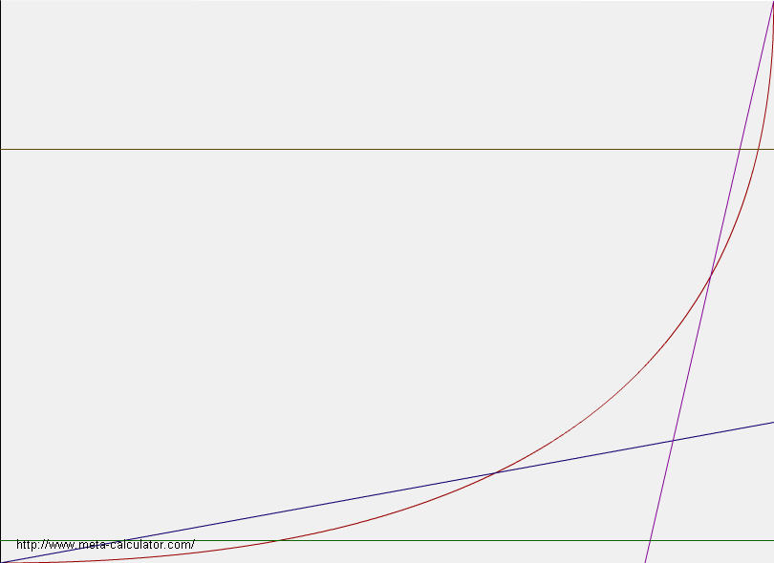
Class 9 and 10 Equation Research
¼ circle method example 1
y=.7347
y =6x-5
y = (1-(1-x)^{.5})²
y =.25x
y=.04
(9/25, .04)
(48/49, .7347)

Slide 139
Class 7 and 8 Equation Research
¼ circle method example 1
I need this TRANSFORMATION
(9/25, .04)
(48/49, .7347)

Slide 140
Class 7 and 8 Equation Research
¼ circle method example 1
6
.25

Slide 141
Class 9 and 10 Equation Research
¼ circle method example 2
Class 5/6 transformation: (r > 1 : concave up)
y = (1-(1-x)^{1/r})^{r}
y’ = (1-(1-x)^{(1/r)})^{(r-1)}(1-x)^{(1/r} ⁻¹⁾
r=2
y = (1-(1-x)^{.5})²
y’ = (1-(1-x)^{.5})(1-x)^{-.5}
y’ = s at x = (1+(2/s) / ((1/s)+1)^{2 0 < s < 1}
y’ = t at x = ((t+1)² -1) / (t+1)^{2 t>1}
y’ = .9 at x= .72299
y’ = 1.2 at x = .79339

Slide 142
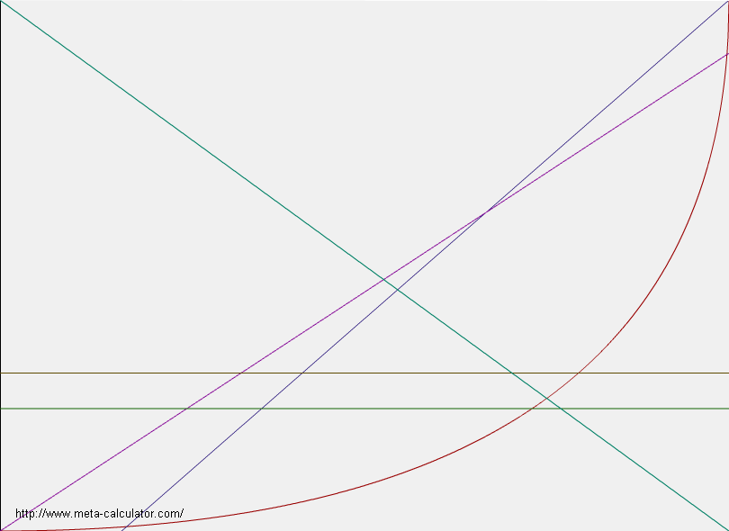
Class 9 and 10 Equation Research
¼ circle method example 2
y =1.2x-.2
y = (1-(1-x)^{.5})²
y =.9x
y=.2975
y=.2307
(.7299, .2307)
(.7934, .2975)

Slide 143
Class 7 and 8 Equation Research
¼ circle method example 2
I need this TRANSFORMATION
(.7299, .2307)
(.7934, .2975)

Slide 144
Class 7 and 8 Equation Research
¼ circle method example 2
1.2
.9
(0,0)
(1,1)

Slide 145
Just to make sure I've got it right, and to help in labeling things,
here's a picture of what we're doing:
1 +..............................................o
| o:
| o :
| o :
| o :
| o :
| o :
| o :
y_b|.......D------------------------B :
| | o | :
| | o | :
| | o | :
| | o | :
y|.......R........P | :
| | o: | :
| | o : | :
| Y| o : | :
| | o : | :
| | o : | :
y_a|.......A--------Q---------------C :
| o : X : : :
| o : : : :
0 o----------------------------------------------+
0 x_a x x_b 1
We've got fixed points A(x_a, y_a) and B(x_b, y_b), and want to
transform to a new set of coordinates X and Y in which A is (0,0) and
B is (1,1). I'll assume that x_b > x_a and y_b > y_b, which will be
true if your function is always increasing.

Slide 146
Our coordinate X is the ratio AQ:AC, and Y is the ratio AR:AD.
Thus, for point P(x,y), we have
AQ x - x_a AR y - y_a
X = -- = --------- Y = -- = ----------
AC x_b - x_a AD y_b - y_a
To express your function in terms of X and Y, we have to invert the
formula for X:
(x_b - x_a)X = x - x_a
x = (x_b - x_a)X + x_a
Given any function y = f(x), we have
y = f(x) = f((x_b - x_a)X + x_a)
and therefore
f((x_b - x_a)X + x_a) - y_a
Y = ---------------------------
y_b - y_a
There's your formula. Let's apply it to your example, where f(x) =
x^2, A is (1/4, 1/16), and B is (1/3, 1/9):
f((1/3 - 1/4)X + 1/4) - 1/16 ((1/3 - 1/4)X + 1/4)^2 - 1/16
Y = ---------------------------- = -----------------------------
1/9 - 1/16 1/9 - 1/16
This simplifies (though you wouldn't need to do this in your program) to
(X/12 + 1/4)^2 - 1/16 (X + 3)^2 - 9
Y = --------------------- = -------------
7/144 7
As a check, when X=0, this gives (9-9)/7 = 0, and when X=1, it gives
(16-9)/7 = 1, just as you wanted.

Slide 147
(0 < m < 1 && n > 1 ) || (0 < n < 1 && m > 1)
(Concave Up) (Concave Down)
Y = ((1-(1-((1-1/(n+1)^2) – (1-1/(m+1)^2))*x - (1-1/(m+1)^2) )^.5)^2
- (1-(1-(1-1/(m+1)^2))^.5)^2)
/ ((n^2 / (n+1)^2) - (m^2 / (m+1)^2))
Y = ((1-(1-((1-1/(6+1)^2) – (1-1/(.25+1)^2))*x - (1-1/(.25+1)^2) )^.5)^2
- (1-(1-(1-1/(.25+1)^2))^.5)^2)
/ ((6^2 / (6+1)^2) - (.25^2 / (.25+1)^2))

Slide 148
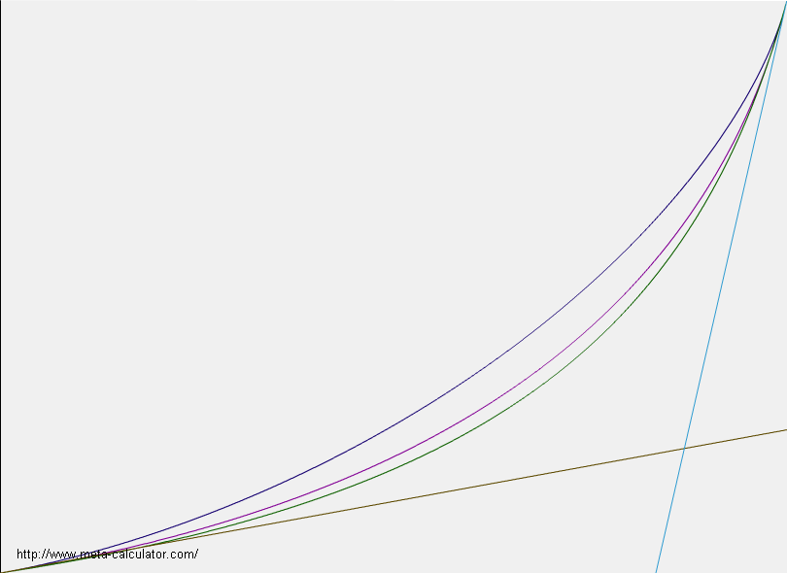
Expanding the ¼ Circle of Death...
y = (1-(1-x)^(1/k))^(k) Y = (1-(1-x)^(1/3))^(3)
y’ = (1-(1-x)^(1/k))^(k-1) * (1-x)^(1/k-1) y’ = (1-(1-x)^(1/3))^(3-1) * (1-x)^(1/3-1)
x = (y^6+3 y^4+3 y^2-sqrt(y^6+3 y^4+3 y^2+1)+1)/(y^6+3 y^4+3 y^2+1) for k=1.5
x = (y’^3-3*y’^2-sqrt(y’^3+6*y’^2+9*y’)+6*y’)/(y’^3-3*y’^2+3*y’-1) for k=3
k=3 k=1.5
y’_{a} = .25 || x_{a} = 0.703704 y_{a} = 0.0370371 || x_{a} = 0.0869247 y_{a} = 0.0142668
y’_{b} = 6 || x_{b} = 0.975637 y_{b} = 0.358067 || x_{b} = 0.995557 y_{b} = 0.959736
Y₃= ((1-(1-(0.975637- 0.703704)*x - 0.703704)^(1/3))^3 - 0.0370371) / (0.358067-0.0370371)
Y_{1.5}= ((1-(1-(0.995557- 0.0869247)*x - 0.0869247)^(1/1.5))^1.5 - 0.0142668) / (0.959736 -0.0142668)
Top curve using k=1.5
Middle curve using k=2
Bottom curve using k=3
It would be excellent to have the full class of godCurves for all k. The difficulty lay in solving the derivative formula for x
6
.25

Slide 149
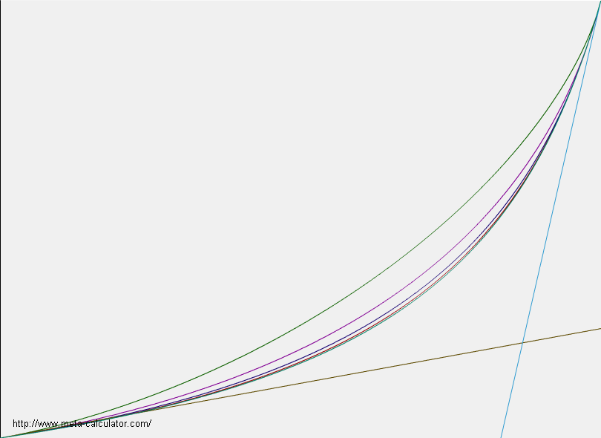
Expanding the ¼ Circle of Death...
y = (1-(1-x)^(1/k))^(k) Y = (1-(1-x)^(1/3))^(3)
y’ = (1-(1-x)^(1/k))^(k-1) * (1-x)^(1/k-1) y’ = (1-(1-x)^(1/3))^(3-1) * (1-x)^(1/3-1)
x = (y^6+3 y^4+3 y^2-sqrt(y^6+3 y^4+3 y^2+1)+1)/(y^6+3 y^4+3 y^2+1) for k=1.5
x = (y’^3-3*y’^2-sqrt(y’^3+6*y’^2+9*y’)+6*y’)/(y’^3-3*y’^2+3*y’-1) for k=3
k=5 k=10
y’_{a} = .25 || x_{a} = 0.931024 y_{a} = 0.0121933 || x_{a} = 0.997952 y_{a} =0.000438866
y’_{b} = 6 || x_{b} = 0.990995 y_{b} = 0.084564 | x_{b} = 0.999657 y_{b} = 0.00251786
Y₁₀= ((1-(1-(0.999657 - 0.997952 )*x - 0.997952 )^(1/10))^10 - 0.000438866) / (0.00251786 - 0.000438866)
Y₅= ((1-(1-(0.990995 - 0.931024)*x - 0.931024)^(1/5))^5 - 0.0121933 ) / (0.084564 - 0.0121933 )
Y₃= ((1-(1-(0.975637- 0.703704)*x - 0.703704)^(1/3))^3 - 0.0370371) / (0.358067-0.0370371)
Y_{1.5}= ((1-(1-(0.995557- 0.0869247)*x - 0.0869247)^(1/1.5))^1.5 - 0.0142668) / (0.959736 -0.0142668)
From top to bottom:
k = 1.5, 2, 3, 5, 10
It would be excellent to have the full class of godCurves for all k. The difficulty lay in solving the derivative formula for x
6
.25

Slide 150
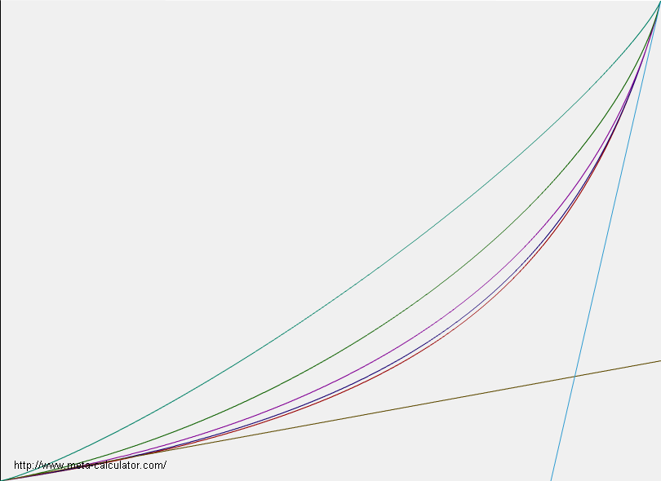
Expanding the ¼ Circle of Death...
y = (1-(1-x)^(1/k))^(k) Y = (1-(1-x)^(1/3))^(3)
y’ = (1-(1-x)^(1/k))^(k-1) * (1-x)^(1/k-1) y’ = (1-(1-x)^(1/3))^(3-1) * (1-x)^(1/3-1)
x = (y^6+3 y^4+3 y^2-sqrt(y^6+3 y^4+3 y^2+1)+1)/(y^6+3 y^4+3 y^2+1) for k=1.5
x = (y’^3-3*y’^2-sqrt(y’^3+6*y’^2+9*y’)+6*y’)/(y’^3-3*y’^2+3*y’-1) for k=3
k=1.2 k=10
y’_{a} = .25 || x_{a} = 0.00117062 y_{a} = 0.000243855 || x_{a} = 0.997952 y_{a} =0.000438866
y’_{b} = 6 || x_{b} = 0.999979 y_{b} = 0.999848 | x_{b} = 0.999657 y_{b} = 0.00251786
Y₁₀= ((1-(1-(0.999657 - 0.997952 )*x - 0.997952 )^(1/10))^10 - 0.000438866) / (0.00251786 - 0.000438866)
Y₅= ((1-(1-(0.990995 - 0.931024)*x - 0.931024)^(1/5))^5 - 0.0121933 ) / (0.084564 - 0.0121933 )
Y₃= ((1-(1-(0.975637- 0.703704)*x - 0.703704)^(1/3))^3 - 0.0370371) / (0.358067-0.0370371)
Y_{1.5}= ((1-(1-(0.995557- 0.0869247)*x - 0.0869247)^(1/1.5))^1.5 - 0.0142668) / (0.959736 -0.0142668)
Y_{1.2}= ((1-(1-(0.999979 - 0.00117062)*x - 0.00117062)^(1/1.2))^1.2 - 0.000243855) / (0.999848 - 0.000243855)
From top to bottom:
k = 1.2, 1.5, 2, 3, 5
It would be excellent to have the full class of godCurves for all k. The difficulty lay in solving the derivative formula for x
6
.25

Slide 151
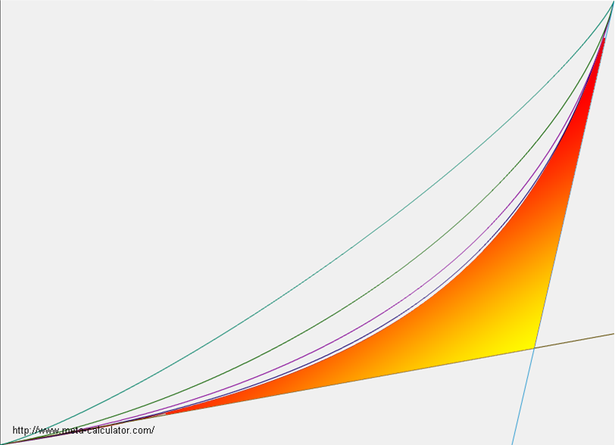
Forbidden Zone

Slide 152
Original Equation:
y = (1-(1-x)^(1/k))^(k) <TAKE DERIVATIVE>
y = (1-(1-x)^(1/2))^(2) example k=2
Slope Equation:
y’ = (1-(1-x)^(1/k))^(k-1)*(1-x)^(1/k-1) <SOLVE FOR X> **DIFFICULT**
x = f(y’(k))
x = (2*y’+y’^2)/(1+y’)^2 example k=2
Choose k > 1 and insert into original equation and slope equation
  Smaller k values cause smooth turns
  Larger k values cause abrupt turns
Choose either a concave up or a concave down curve
Insert 1st desired slope and find corresponding x_{a} value
  Concave Up: 0 < 1st slope < 1
  Concave Down: 1st slope > 1
Insert 2nd desired slope and find corresponding x_{b} value
  Concave Up: 2nd slope > 1
  Concave Down: 0 < 2nd slope < 1
Insert x_{a} into original equation to get y_{a}
Insert x_{b} into original equation to get y_{b}
Insert x_{a}, x_{b}, y_{a}, y_{b}, and k into transformed equation
Transformed Equation:
y = ((1-(1-(x_{b}-x_{a})*x-x_{a})^(1/k))^(k) – y_{a}) / (y_{b} – y_{a})

Slide 153
Failed Attempts at Curve Equations
(like switch functions)
For Curiosities Sake before I discovered the Quarter Circle of Death technique

Slide 154
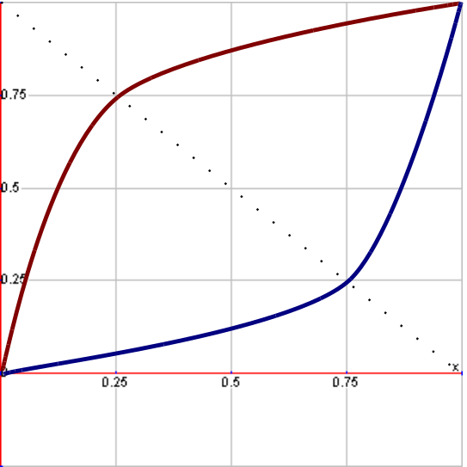
Class 7 and 8 Equation Research
The goal is to find equations that start at a slope of n at
(0,0) and a slope of 1/n at (1,1)
Ideally, the curve should be symmetrical along y=-x+1

Slide 155
Class 7 and 8 Equation Research
I have had no luck getting one equation to do the job so…
I am transitioning between two equations using ‘switch functions’.
A basic format for the full curve equation:
y = switch function_{(max 0)} * equation A
+ switch function_{(max 1)} * equation B
The blue indicates that the switch function will have a value of 1 at x=0 and a value of 0 at x=1
The red indicates that the switch function will have a value of 0 at x=0 and a value of 1 at x=1

Slide 156
Class 7 and 8 Equation Research
Likely compatible candidates for equations A and B would come from classes:
Class 3 & Class 1 (Concave up)
Class 4 & Class 2 (Concave down)
An example for the full curve equation:
(If n > 1: concave up / if 0 < n < 1: concave down)
y = switch function_{(max 0)} * (1-(1-x)^{(1/n)})
+ switch function_{(max 1)} * x^{n}

Slide 157
Class 7 and 8 Equation Research
Likely compatible candidates for switch functions are:
1-x (x)
1-x^{n} (x^{n})
1-x^{(1/n)} (x^{(1/n)})
cos(πx/2) (1-cos(πx/2))
|(n^{x}-n)/(1-n)| |(n^{x}-1)/(n-1)|
An example for the full curve equation:
(If n > 1: concave up / if 0 < n < 1: concave down)
y = (1-x) * (1-(1-x)^{(1/n)})
+ (x) * x^{n}

Slide 158
Class 7 and 8 Equation Research
Candidate 1
y = abs((n^x - n) / (1-n)) * (1-(1-x)^(1/n))
+ abs((n^x -1)/(n-1)) * (x^n)

Slide 159
Class 7 and 8 Equation Research
Candidate 2
y = [(1-x) * (1-(1-x)^(1/n))
+ (x) * (x^n)
+ (1-x^n) * (1-(1-x)^(1/n))
+ (x^n) * (x^n)] / 2
The average of two curve equations

Slide 160
Class 7 and 8 Equation Research
Future
Adding a third switch function that has a value of 0 at x=0 and x=1 and a max value of 1 at .5
  Example: f(x) = abs(cos(πx))
Incorportating the inflection point into the curve equations.
  x= (n -n⁻¹) ⁻¹
This intersection point is found by setting the following straight lines equal to each other and:
y= n⁻¹x and y= nx-1
Trying to find the ONE ideal equation without switch functions
  Transformation of the ¼ circle

Slide 161
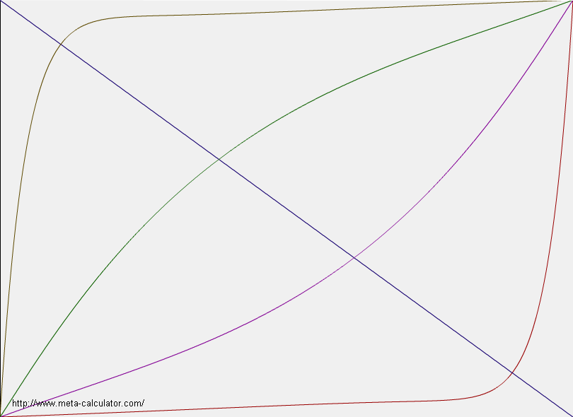
Class 7,8
Candidate 1
y = abs((r^{x} -1) / (r-1)) * (x^{r}) +
abs((r^{x} - r) / (r-1)) * (1-(1-x)^{(1/r)})
Class 7: r > 1 concave up
Class 8: r < 1 concave down
y’ (0) = m_{Unit} = r
y’ (1) = n_{Unit} = 1/r
As can be seen with slope 20 and .05, the curves are not symmetric around y=-x+1
2
20
1/2
1/20

Slide 162
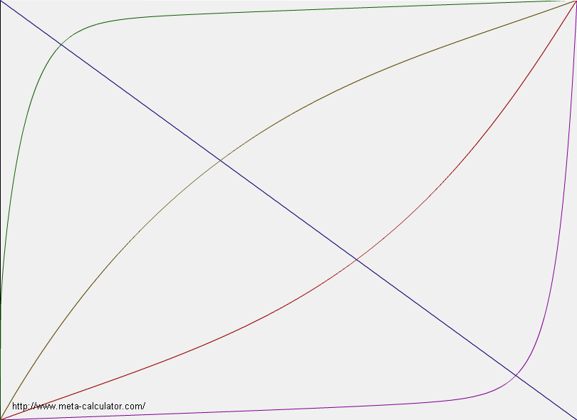
Class 7,8
Candidate 2
y = [(1-x) * (1-(1-x)^(1/n))
+ (x) * (x^n)
+ (1-x^n) * (1-(1-x)^(1/n))
+ (x^n) * (x^n)] / 2
Class 7: r > 1 concave up
Class 8: r < 1 concave down
y’ (0) = m_{Unit} = r
y’ (1) = n_{Unit} = 1/r
As can be seen with slope 20 and .05, the curves are not symmetric around y=-x+1 but better than candidate 1
2
20
1/2
1/20

Slide 163
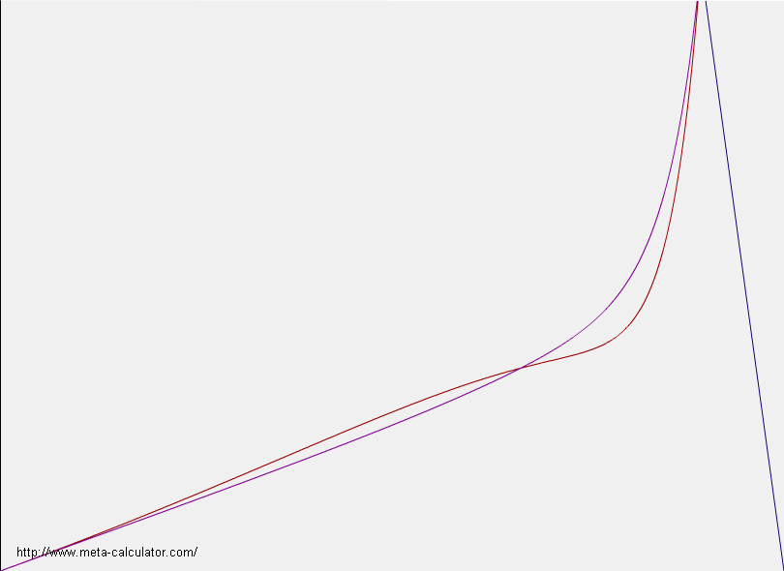
Class 7,8
Candidate 1 vs. 2
This is a zoomed in view from y= 0 to y=0.1 (x=0 to 1)
In this view, it is obvious that both candidates are still not symmetrical.
In addition, the warping in candidate 1 is made obvious
2
20
Can. 2
Can. 1
1/2
1/20

Slide 164
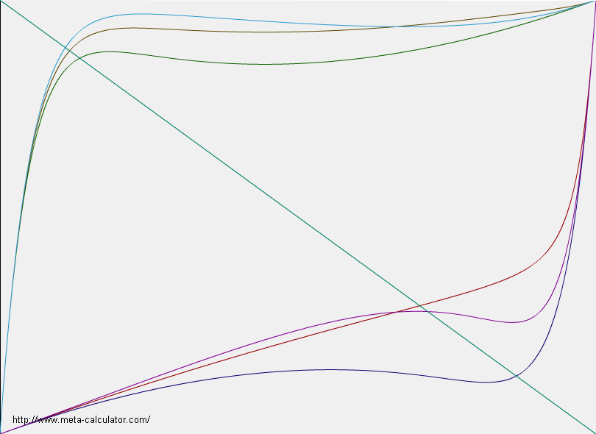
Class 9,10
Candidates
Green and Violet:
(1-x) * (1-(1-x)^(20)) + (x) * (x^(1/2))
(1-x) * (1-(1-x)^(1/2)) + (x) * (x^20)
Blue and Magenta
abs((20^x -20) / (20-1)) * (1-(1-x)^(20)) + abs((20^x -1) / (20-1)) * (x^(1/2))
abs((20^x -20) / (20-1)) * (1-(1-x)^(1/2)) + abs((20^x -1) / (20-1)) * (x^20)
Brown and Red
((1-x) * (1-(1-x)^(20)) + (x) * (x^ (1/2)) + (1-x^(20)) * (1-(1-x)^(20)) + (x^(20)) * (x^(1/2))) / 2
((1-x) * (1-(1-x)^(1/2)) + (x) * (x^20) + (1-x^20) * (1-(1-x)^(1/2)) + (x^20) * (x^20)) / 2
1/20
1/2
20
20
20
2
1/2
1/2

Slide 165
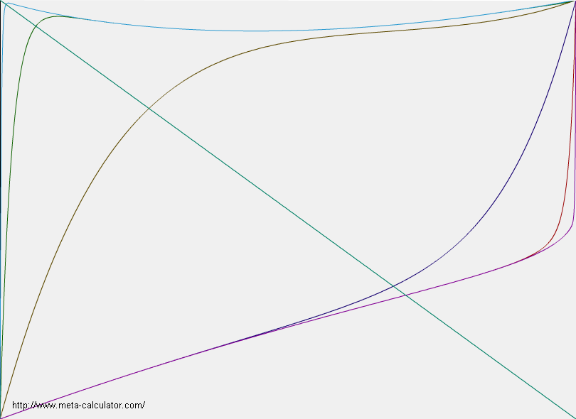
Class 9,10
Candidate 1
Concave Down (class 10)
((1-x) * (1-(1-x)^(20)) + (x) * (x^ (1/2)) + (1-x^(20)) * (1-(1-x)^(20)) + (x^(20)) * (x^(1/2))) / 2
Concave Up (class 9)
((1-x) * (1-(1-x)^(1/2)) + (x) * (x^20) + (1-x^20) * (1-(1-x)^(1/2)) + (x^20) * (x^20)) / 2
Class 10 needs help
500
.5
5
20
50
20
50
500
5
.5

Slide 166
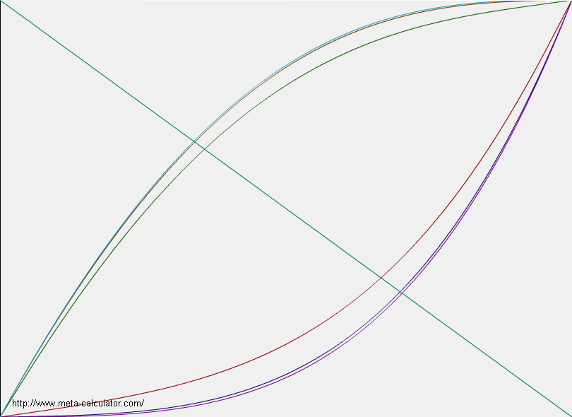
Class 9,10
Candidate 1
1/500
Concave Down
((1-x) * (1-(1-x)^(2)) + (x) * (x^ (r)) + (1-x^(2)) * (1-(1-x)^(2)) + (x^(2)) * (x^(r))) / 2
Concave Up
((1-x) * (1-(1-x)^(r)) + (x) * (x^2) + (1-x^2) * (1-(1-x)^(r)) + (x^2r) * (x^2)) / 2
Both versions look good
1/50
1/5
2
50
500
2
1/5
1/50
1/500

Slide 167
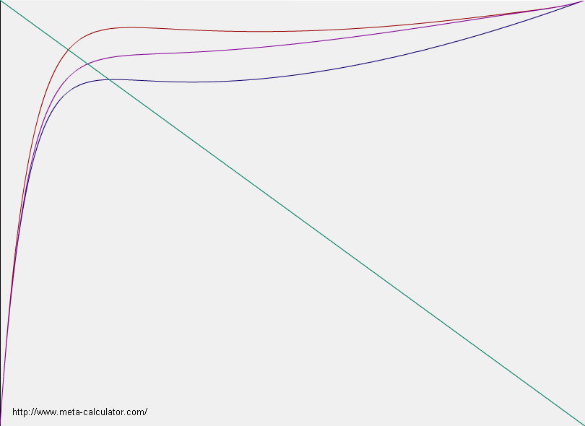
Class 10
Revisited
Red
((1-x) * (1-(1-x)^(20)) + (x) * (x^ (1/2)) + (1-x^(20)) * (1-(1-x)^(20)) + (x^(20)) * (x^(1/2))) / 2
Magenta !!!
((1-x^20) * (1-(1-x)^(20)) + (x^20) * (x^ (1/2)) + (1-x^(1/2)) * (1-(1-x)^(20)) + (x^(1/2)) * (x^(1/2))) / 2
Violet
((1-x) * (1-(1-x)^(20)) + (x) * (x^ (1/2)) + (1-x^(1/2)) * (1-(1-x)^(20)) + (x^(1/2)) * (x^(1/2))) / 2
1/2
20

Slide 168
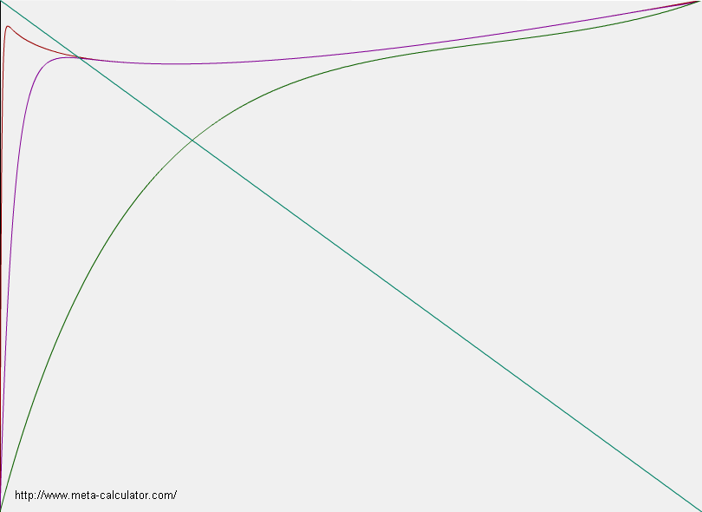
Class 10
Revisited
((1-x^r) * (1-(1-x)^(r)) + (x^r) * (x^ (1/2)) + (1-x^(1/2)) * (1-(1-x)^(r)) + (x^(1/2)) * (x^(1/2))) / 2
Still kind of crappy
500
.5
50
5

Slide 169
Node placement and node ordering
50
(20, 35)
(-35, 30)
1
5
2
(20, 15)
0
-50
50
(7, -10)
3
4
(-15, -30)
-50

Slide 170
Line cross check (failed)
50
(20, 35)
(-35, 30)
2
1
X
5
(20, 15)
X
0
-50
50
34
12 45
12 56
45
23 56
23 61
34 56
34 61
45 61
(7, -10)
3
4
(-15, -30)
-50

